Slide 1

LOAN PREDICTION SYSTEM USING MACHINE LEARNING
Presented By: Sajeela Khan (SP22-BCS-012)
Muhammad Hamza Zia (SP22-BCS-026)
Danyal Shah (SP22-BCS-038)

Slide 2
INTRODUCTION
The loan prediction system plays a crucial role in the banking and financial sector by evaluating the creditworthiness of potential borrowers. Traditional methods often depend on manual assessments and subjective judgment, resulting in errors and biases. In contrast, machine learning techniques provide a more efficient and accurate approach by analyzing historical data and identifying patterns to predict loan outcomes.

Slide 3
SIGNIFICANCE
This project is significant because it leverages historical data and machine learning algorithms to accurately predict the likelihood of loan repayment. By enhancing decision-making processes, reducing default risks, and improving operational efficiency, this project ultimately enhances the overall quality of lending operations for banks.

Slide 4

LITERATURE REVIEW
Prediction of Loan Approval in Banks using Machine Learning Approach by Viswanatha v. and Ramachandra Ac. (August 2023, International Journal of Engineering and Management Research Volume 13, Issue 4 )
Models:
Random Forest
Naive Bayes
Decision Tree
KNN
Dataset:
Records/Rows: 614
Attributes/Columns: 13
Conclusion:
Obtained an accuracy of 83.73% with Naïve Bayes algorithm.

Slide 5
LITERATURE REVIEW
The Loan Prediction using Machine Learning by Dr.C K Gomathy, Ms.Charulatha,Mr.AAkash ,Ms.Sowjanya (Oct 2021, International Research Journal of Engineering and Technology (IRJET) Volume: 08 Issue: 10 )
Model:
Decision Tree
Dataset:
Attributes/Columns: 13
Conclusion:
In near future this module of prophecy can be integrated with the
module of automated processing system.

Slide 6

METHODOLOGY
DATA COLLECTION:
Source: Kaggle
Records/Rows: 4269
Attributes/Columns: 13

Slide 7
METHODOLOGY
DATA PROCESSING:
Checking for duplicate values
Convert values in a column to Absolute Values
Remove white spaces from Columns
Handel missing values
Adding new columns to the data frame

Slide 8
METHODOLOGY
HANDEL MISSING VALUES:
For numerical columns we will fill missing values with the mean
For categorical columns we will fill the missing values with the frequent value

Slide 9
METHODOLOGY
ADDING NEW COLUMNS TO THE DATA FRAME:
Adding CIBIL rating column
Adding income level column
Adding loan rating column
Adding loan term column
Adding dependent level column

Slide 10
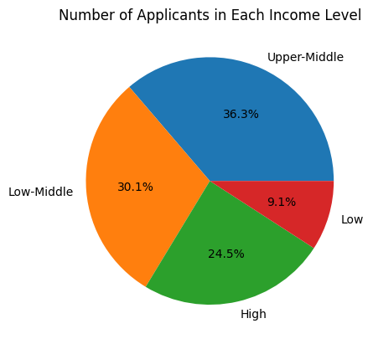
METHODOLOGY
EXPLORATORY DATA ANALYSIS
Segmentation according to Income
if 100000 <= value <= 1000000:
return "Low"
elif 1000001 <= value <= 4000000:
return "Low-Middle"
elif 4000001 <= value <= 7500000:
return "Upper-Middle"
elif 7500001 <= value <= 10000000:
return "High"
else:
return "Very High Income"

Slide 11
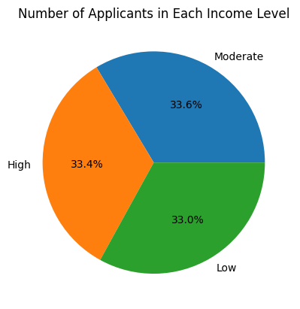
METHODOLOGY
EXPLORATORY DATA ANALYSIS
Segmentation according to Dependents
def dependents(value):
if 0 <= value <= 1:
return "Low"
elif 2 <= value <= 3:
return "Moderate"
elif 4 <= value <= 5:
return "High"
else:
return "Unknown"
df['Dependent Level'] = df['no_of_dependents’]
.apply(dependents)

Slide 12
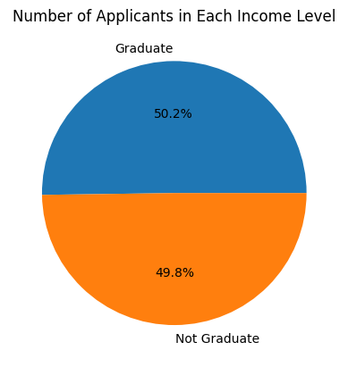
METHODOLOGY
EXPLORATORY DATA ANALYSIS
Segmentation according to Education
education = df['education'].value_counts().reset_index()
education = education.rename(columns={'education':'Education Levels', 'count': "Number_of_Applicants"})
education

Slide 13
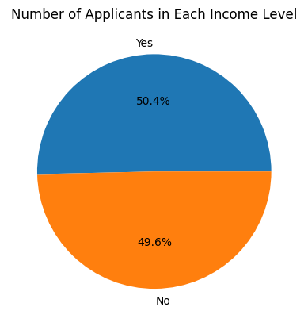
METHODOLOGY
EXPLORATORY DATA ANALYSIS
Segmentation according to Employment
employment = df['self_employed'].value_counts().reset_index()
employment = employment.rename(columns={'self_employed':'Self Employed', 'count': "Number_of_Applicants"})
employment

Slide 14


METHODOLOGY
RATE OF LOAN APPROVAL
Loan approval according to the level of Education
Loan approved according to the type of Employment
The influence of CIBIL Rating on loan approval

Slide 15
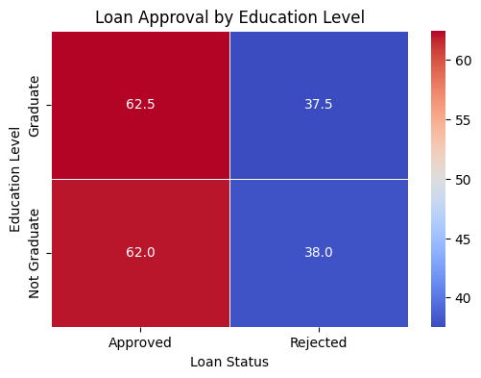
METHODOLOGY
LOAN APPROVAL ACCORDING TO THE LEVEL OF EDUCATION

Slide 16
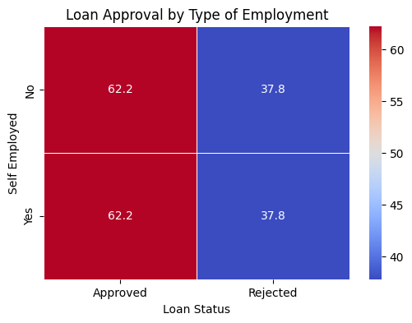
METHODOLOGY
LOAN APPROVAL ACCORDING TO THE TYPE OF EMPLOYMENT

Slide 17
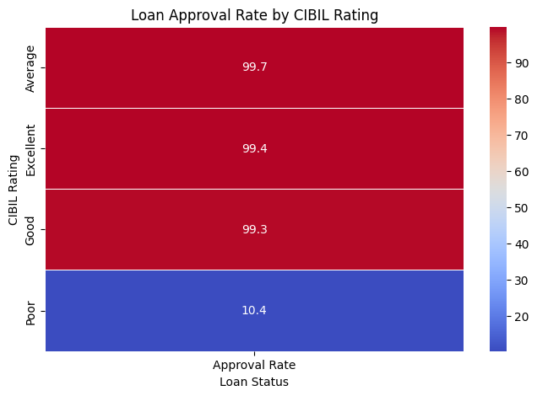
METHODOLOGY
LOAN APPROVAL ACCORDING TO THE CIBIL RATING

Slide 18
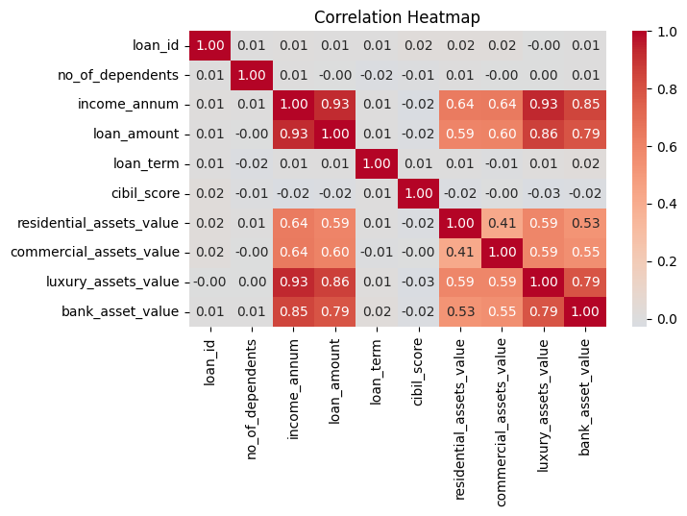
METHODOLOGY
FEATURE SELECTION
Correlation Analysis
Correlation between asset value and income
Correlation between asset value and Loan

Slide 19
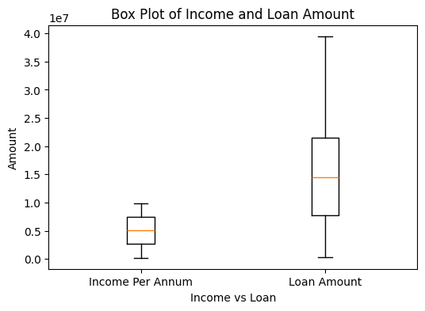
METHODOLOGY
FEATURE SELECTION
Correlation between Loan amount and Income

Slide 20

METHODOLOGY
MODEL DEVELOPMENT
Logistic Regression | Classifies binary outcomes.
Random Forest | Combines decision trees.
Naïve Bayes | Assumes feature independence.
SVM | Maximizes classification margin.

Slide 21
METHODOLOGY
MODEL EVALUATION
Model Train Dataset
Logistic Regression 92%
Random Forest 100%
Naïve Bayes 92%
SVM 91%

Slide 22
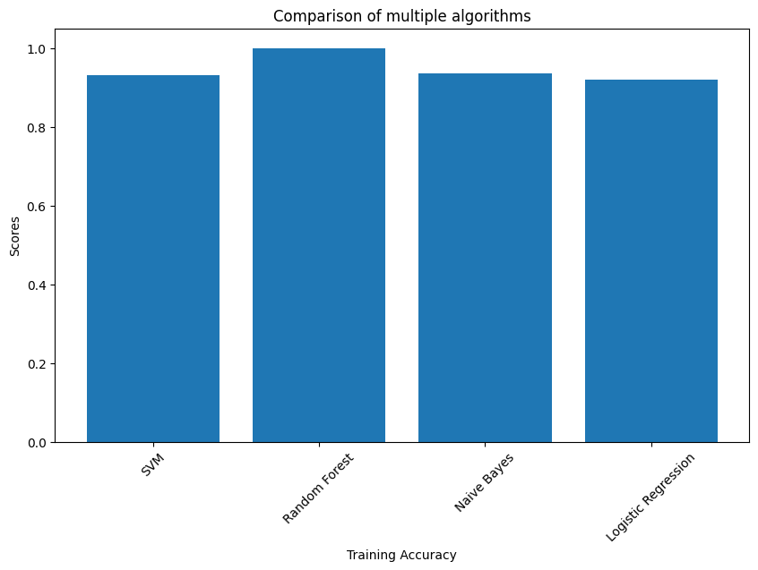
METHODOLOGY
MODEL EVALUATION
Train Dataset Accuracy:

Slide 23
METHODOLOGY
MODEL EVALUATION
Model Test Dataset
Logistic Regression 91%
Random Forest 98%
Naïve Bayes 93%
SVM 92%

Slide 24
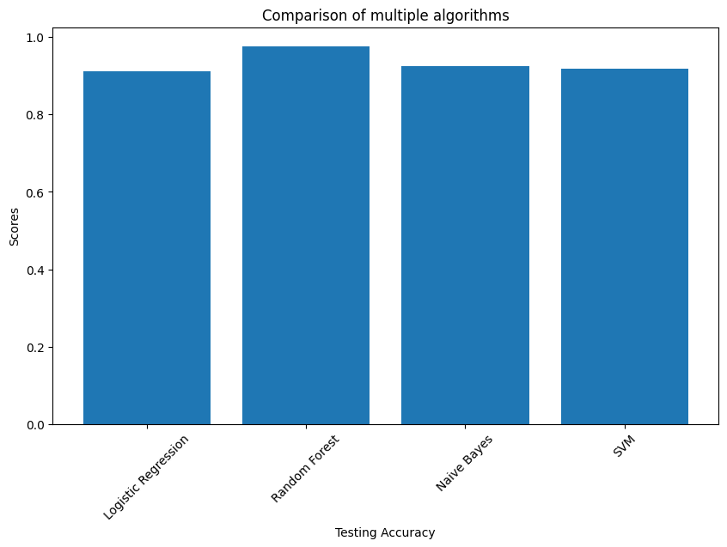
METHODOLOGY
MODEL EVALUATION
Test Dataset Accuracy:

Slide 25
METHODOLOGY
MODEL EVALUATION
Test Dataset Train Dataset
Logistic Regression 91% 92%
Random Forest 98% 100%
Naïve Bayes 93% 92%
SVM 92% 91%

Slide 26
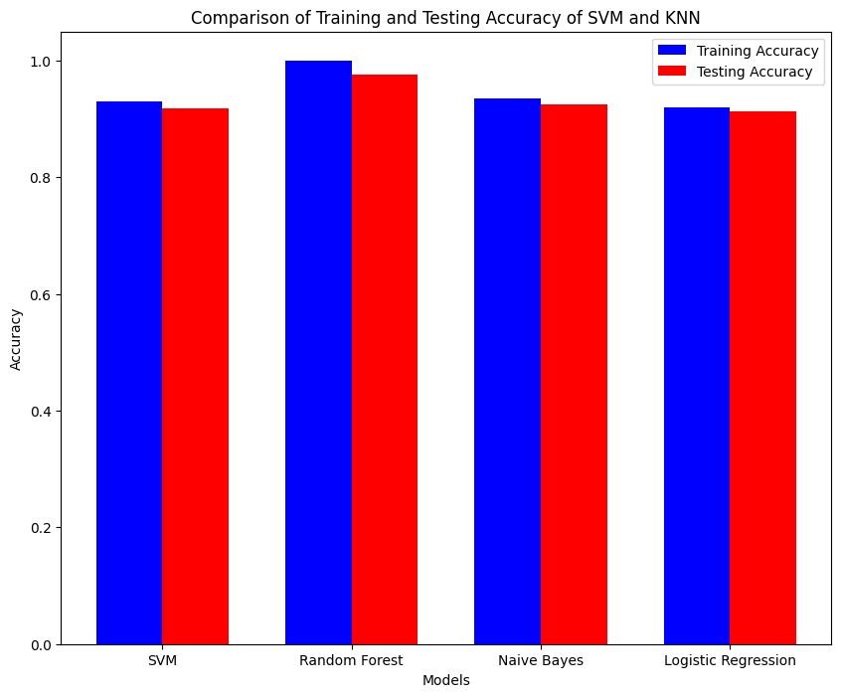
METHODOLOGY
MODEL EVALUATION
Test and Train Dataset Accuracy:

Slide 27

CONCLUSION
Random Forest is best as its training/testing accuracy is higher than others. This project successfully developed a loan prediction system using machine learning techniques, aiming to enhance the accuracy and efficiency of loan approval processes in the banking and financial sector.

Slide 28

THANKS.

Slide 29
REFERENCES
DATASET:
https://www.kaggle.com/datasets/pravinmaurya69/loan-approval-prediction-dataset/data
RESEARCH PAPERS:
https://www.researchgate.net/publication/372909313_Prediction_of_Loan_Approval_in_Banks_using_Machine_Learning_Approach
https://www.researchgate.net/publication/357449126_THE_LOAN_PREDICTION_USING_MACHINE_LEARNING

